Slide 1
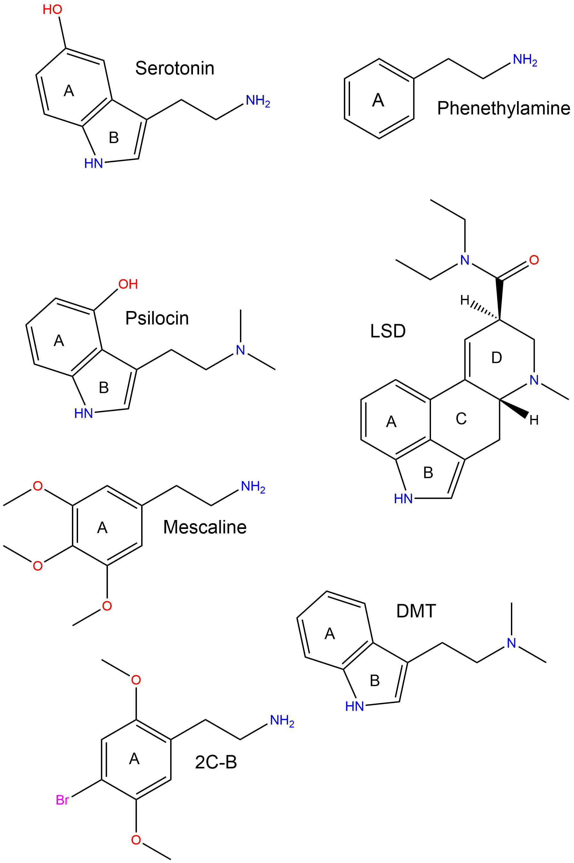
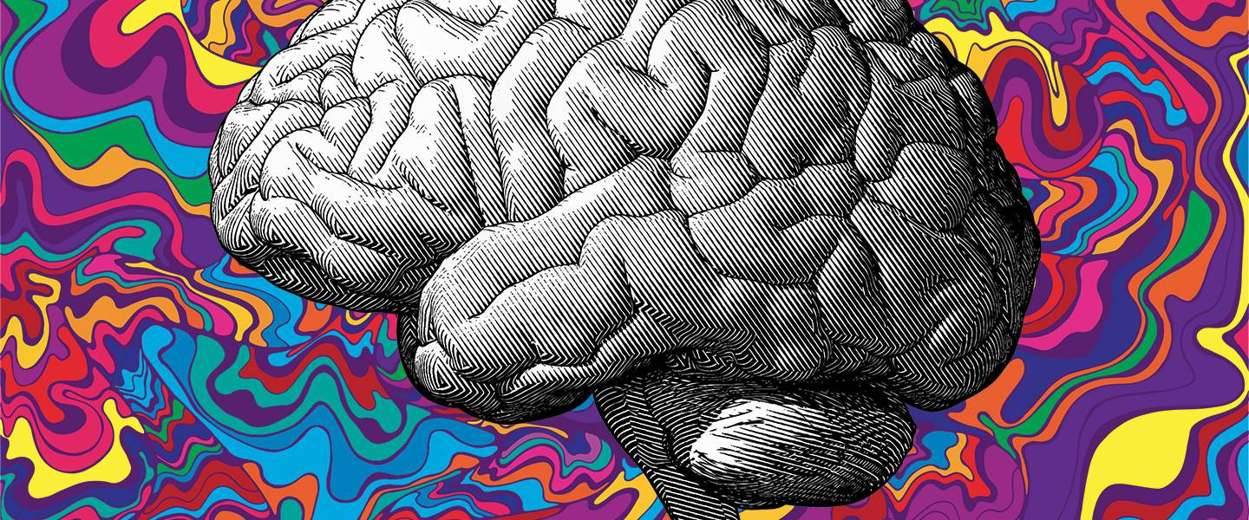
Introduction to Serotonergic Psychedelics
Kevin Krupp

Slide 2
What are Psychedelics?
Powerful psychoactive substances that lead to acute altered states of consciousness
Altered sensory perception
Visual / auditory hallucinations and synesthesia

Slide 3
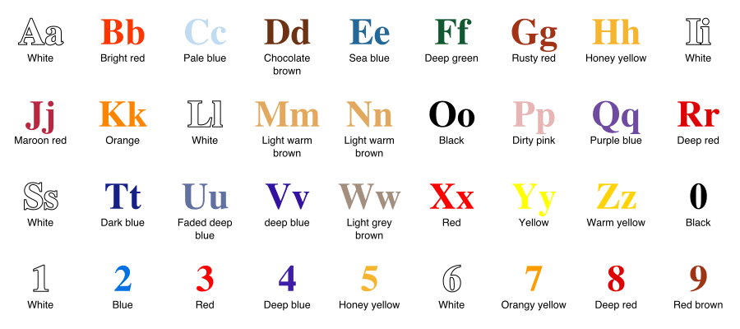
Synesthesia - stimulation of one sensory/cognitive pathway leading to automatic & involuntary experiences in another sensory/cognitive pathway.
Projective synesthesia:
See actual colors, forms, or shapes when stimulated
Associative synesthesia:
Feel a very strong and involuntary connection between the stimulus and the sense that it triggers.

Slide 4
What are Psychedelics?
Powerful psychoactive substances that lead to acute altered states of consciousness
Altered sensory perception
Visual / auditory hallucinations and synesthesia
Closed eye visualizations
Perception of time
May appear to speed up/slow down
Sense of Self
Ego dissolution
Increased feelings of connectedness to others / nature / universe
Temporarily impair working memory
Mood
Mystical Experience (”Good Trip”)
Psychosis / Anxiety (“Bad Trip”)
“it's a synesthesia of areas of brain with consciousness of self and the external environment. You lose track of which is which.”
Enzo Tagliazucchi
http://iacopoapps.appspot.com/hopalongwebgl/

Slide 5
Altered States of Consciousness (ASC)
“Mental state induced by any psychological, physiological, or pharmacological manipulations that significantly deviates from normal waking consciousness” (Ludwig 1966)
Dittrich (1985) determined 3 primary etiology-independent dimensions measured by Altered States of Consciousness Questionnaire (ASCQ)
1. Oceanic Boundlessness → Reflects highly pleasurable state of self-dissolution
2. Anxious ego-dissolutions → State of anxious ego-dissolution
3. Visionary restructuralization → Intensity of sensory / perceptual alterations

Slide 6
Oceanic Boundlessness
Comprises items that measures:
Alterations of ego-boundaries
Experience of unity and transcendence of space & time
Spiritual experiences
Sense of intuitive understanding
Changes in emotions ranging from heightened mood to bliss and ecstasy.
2. Anxious ego-dissolutions
Characterized by:
Disintegration of the coherent self/ego or separation of the self from the world
Loss of self control over one’s autonomy
Cognitive impairment
Anxiety / panic
Motor disturbances or catatonia.
3. Visionary restructuralization
Assessing elementary and complex pseudohallucinations or true hallucinations or illusions
Audio-visual synesthesia’s
Changed meaning of percepts
Vivid recollection of memories and imagery from memory
Facilitated imagination.

Slide 7
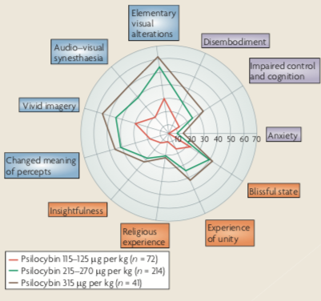

Slide 8
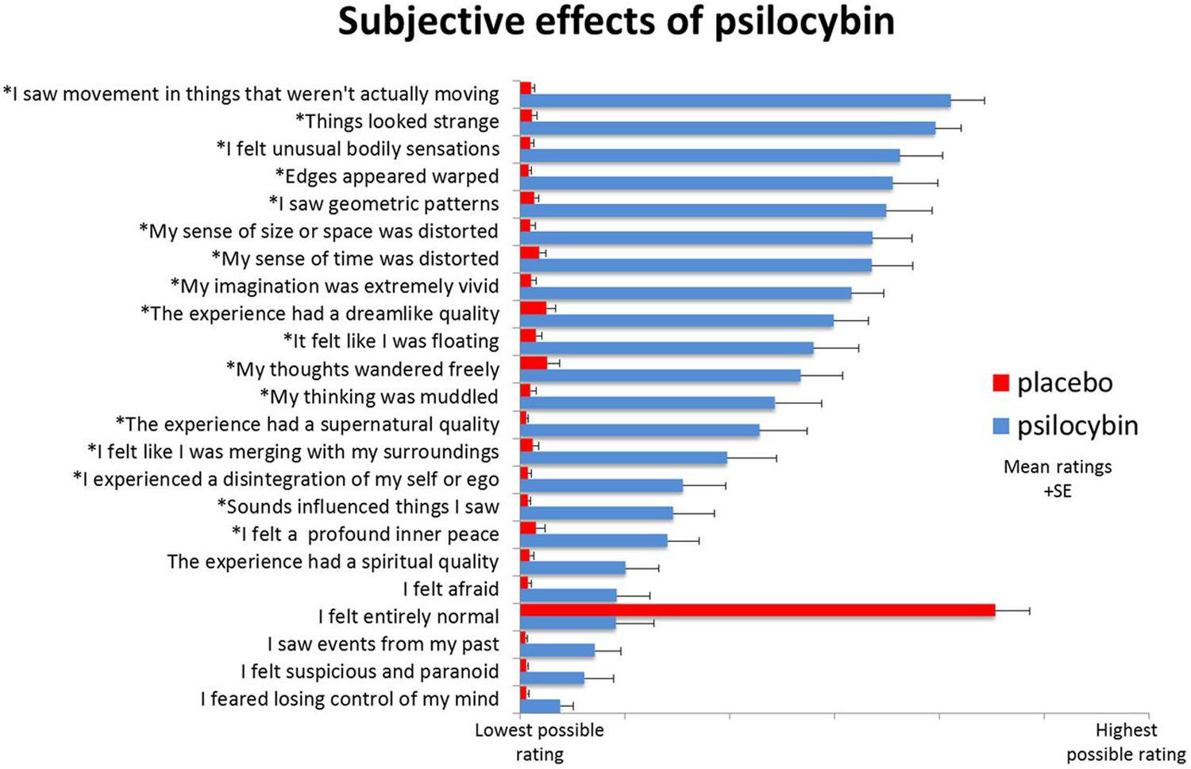
Swanson, L.R. 2018

Slide 9
Subtle effects described as ‘softening’ of ego w/ increased insight into one’s own habitual patterns of:
Thought, behavior, personal problems, and past experiences (Grof, 1980)
Ego dissolution is more likely to occur at higher doses (Griffiths et al., 2011; Studerus et al., 2011, 2012; Liechti et al., 2017)
Some psychedelic drugs cause ego dissolution experience more reliably than others
Psilocybin found to produce full ego dissolution more reliably compared with LSD (Liechti et al., 2017).
Swanson, L.R. 2018

Slide 10
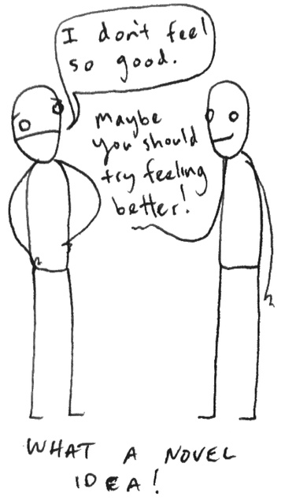
Enhanced Suggestibility
(Carhart-Harris et al. 2015)
LSD vs. placebo control (N=15)
LSD ↑ suggestibility compared to control
- Degree of suggestibility enhancement positively correlated baseline measure of conscientiousness

Slide 11
“ …the feature that distinguishes the psychedelic agents from other classes of drug is their capacity reliably to induce states of altered perception, thought, and feeling that are not experienced otherwise except in dreams or at times of religious exaltation” (Jaffe 1990)
Full of unspecifiable significance; exciting wonder and awe
(D. Nichols 2016)

Slide 12
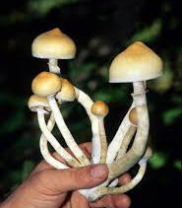
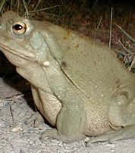
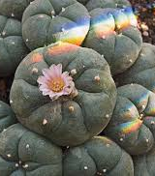
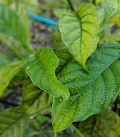
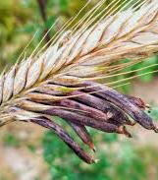
Where are they found?
Psilocybin
5-MeO-DMT
DMT
Mescaline
Many naturally occurring compounds produced by various plants/fungi/animals
Plants containing DMT can be found almost anywhere
DMT
Ergot → LSD
DMT

Slide 13
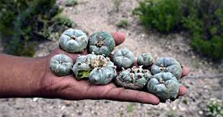
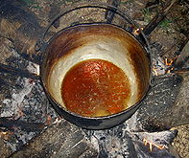
Traditional Religious Uses
Amazonian tribes – Ayahuasca (DMT + MAOI)
Guided by shaman
Often accompanied w/ chanting, music, singing
Usually fasting beforehand
Native American tribes – Peyote (Mescaline)
Ancient Greece – Kykeon (Unknown)
Eleusinian Mysteries
Fasting beforehand
Hinduism - Soma (Unknown)

Slide 14
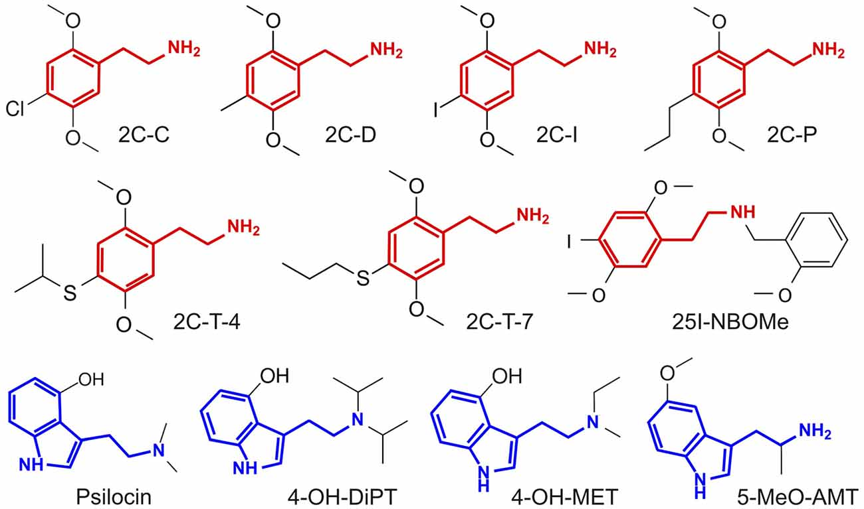
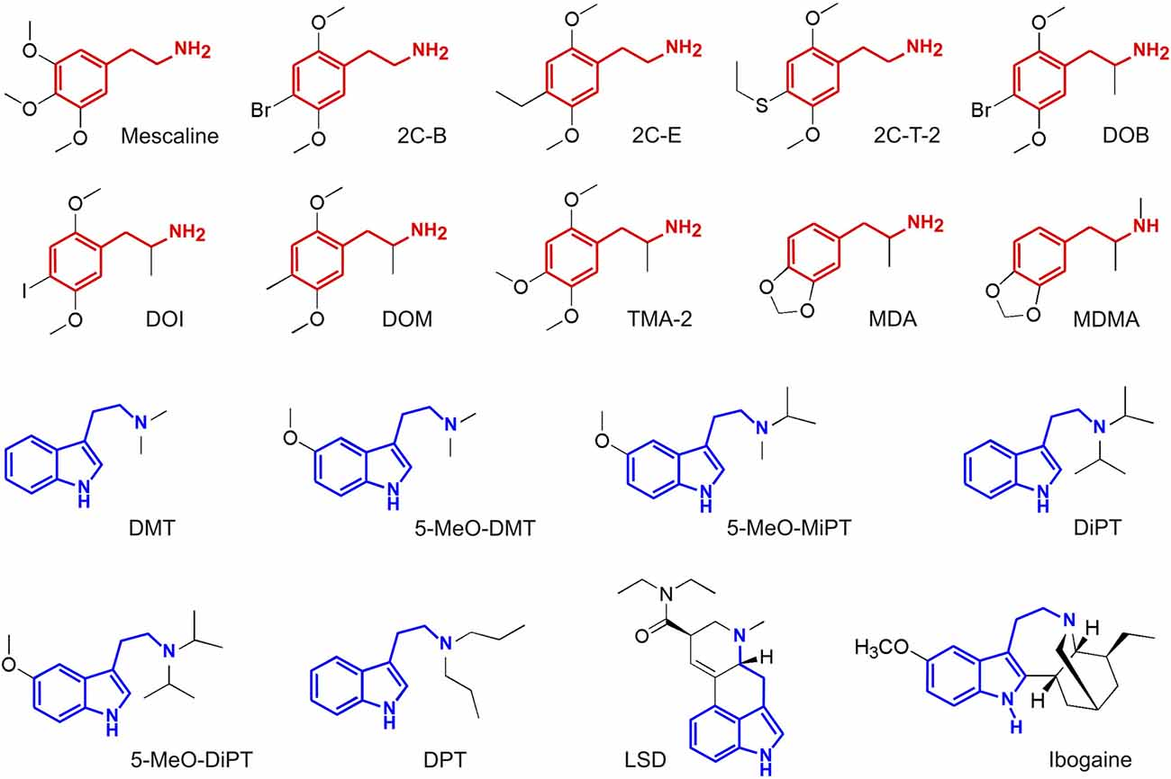
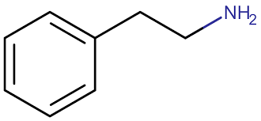
Serotonergic Psychedelics Structures
= Tryptamine
= Phenethylamine
F. Zamberlan et al. 2018

Slide 15
Classic Serotonergic
Psychedelics
*5-HT_{2A} agonists*
-Tryptamines-
N,N-Dimethyltryptamine (DMT)
-K_{i} 5-HT_{2A} (nM) = 237
Psilocybin → Psilocin
K_{i} 5-HT_{2A} (nM) = 15- 25
Mescaline
K_{i} 5-HT_{2A} (nM) = 550
-Ergot Alkaloid-
Lysergic Acid Diethylamide (LSD)
K_{i} 5-HT_{2A} (nM) = 2.4

Slide 16
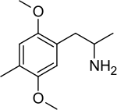
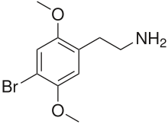
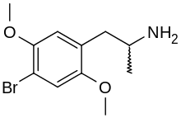
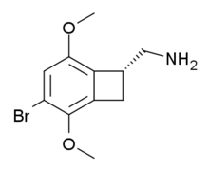
All are 5-HT_{2A} agonists
Phenethylamine Serotonergic
Psychedelics
- Phenethylamines -
+/- DOI (partial agonist)
K_{i} 5-HT_{2A} (nM) = 0.7
Human dose = 1.5 – 3.0 mg
(-) DOI *more behaviorally potent*
2-3 times in drug discrimination/generalization
2x more potent at produce Head Twitch Response (HTR) in rodents
2x more active in humans
DOM
2C-B
TCB-2 (conformationally stable)
DOB
(S)-DOI
(DOM)
(R)-DOI
(2C-B)
(DOB)
(TCB-2)

Slide 17
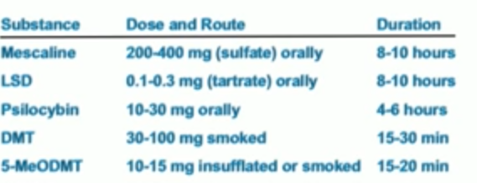

Slide 18
5-HT_{2A} necessary for psychedelic effects
Pre-administration of 5-HT_{2A} antagonist (Ketanserin) ↓ subjective effects in humans
Psilocybin (Vollenweider et al., 1998; Kometer et al., 2013)
LSD (Kraehenmann et al., 2017a,b; Preller et al., 2017)
Ayahuasca (Valle et al., 2016)
Also blocks the Head Twitch Response & other behaviors in rodents

Slide 19
(Nichols 2017) Psychedelic Neuroscience

Slide 20
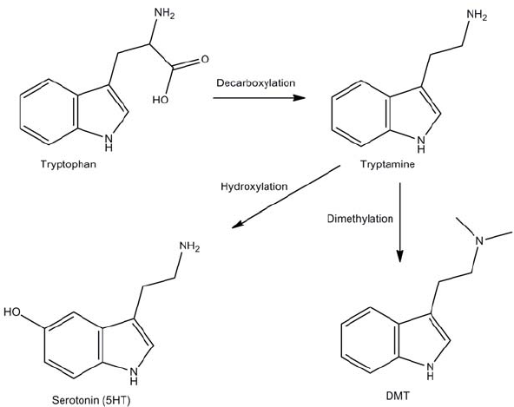
Dimethyltryptamine
Produced by many plants and mammal
Also σ-1 Receptor agonist
DMT ↑ after cardiac arrest (J. Borjigin et al, 2019)
Extracellular concentrations of DMT in the cerebral cortex of normal behaving rats were similar to other monoamine neurotransmitters including serotonin
w/ or w/o pineal gland
A significant increase of DMT levels in the rat visual cortex was observed following induction of experimental cardiac arrest
independent of an intact pineal gland
INMT
Widely expressed in mammalian tissues
Lungs, adrenals, thyroid, lymph nodes, placenta, heart, pancreas, retina, pineal gland

Slide 21
Ayahuasca
5-HT_{2A} + Harmaline (MAOI)
Contributions of harmaline to therapeutic effects?
Placebo in depression study

Slide 22
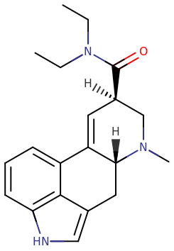
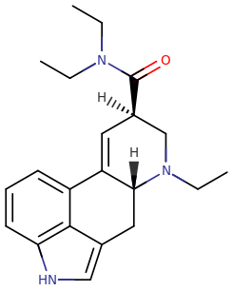
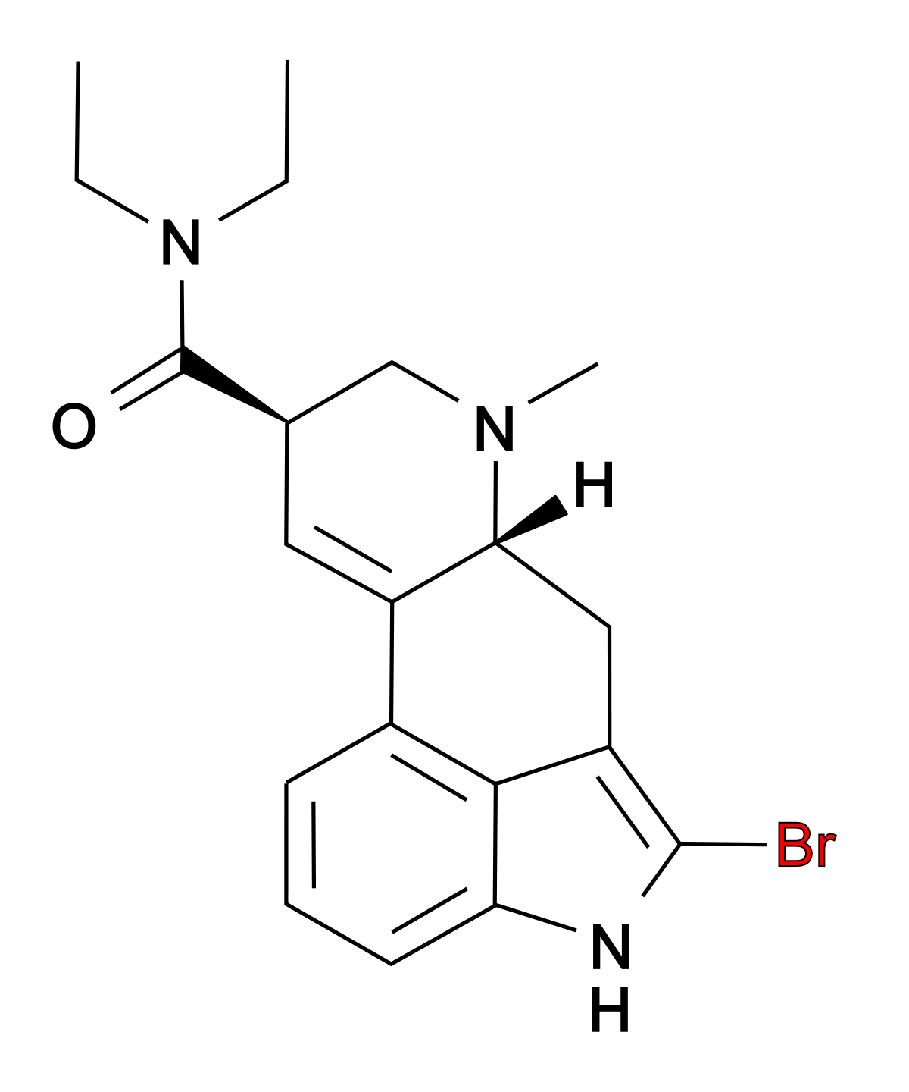
Eth-LAD
2-3x more active than LSD
5-HT_{2A} K_{i} = 0.8 nM
2-Br-LSD
Non-psychedelic
5-HT_{2A} K_{i} = 2.2 nM
LSD
5-HT_{2A} K_{i} = 1.1 nM

Slide 23
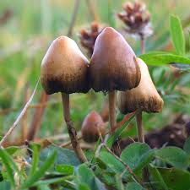
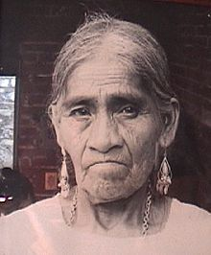
Psilocybin
Psilocybin --> Psilocin
β-Carbolines recently found to occur in psilocybin mushrooms (Blei F, Dörner S, Fricke J, et al. 2019)
Cordysinin C, Cordysinin D, Harmane, Harmol, Norharmane & Perlolyrine
Psilocybin producing bacteria (Jones A., et al. 2019)
Maria Sabina

Slide 24
Safety of Psychedelics
Do not produce dependence
Safe in a controlled / clinical setting
Therapist intervention reduces adverse reactions
Rapid tolerance
LSD admin. daily → loss of sensitivity by day 4
DOM admin. daily → loss of sensitivity by day 3
Cross-tolerance occurs between LSD, Psi, Mescaline
Humans & rodents (Head twitch response)
LSD, DOI, DOB, DOM produce rapid tolerance in rodents via down-regulation of 5-HT_{2A}
No change in 5-HT_{2C}
Comfortable set / setting

Slide 25
Safety of Psychedelics
Phenethylamines -reported to cause overdose deaths
LSD, psilocybin, mescaline, DMT have not
8 individuals insufflated an extremely high dose of LSD
Plasma LSD levels between 1000 and 7000 mg/100 ml
Individuals all became comatose, with hyperthermia, vomiting, light gastric bleeding, and respiratory problems.
With treatment, all without apparent residual effects (Klock et al., 1974).
Though not directly responsible for deaths, judgment is impaired while under the influence of these drugs
Particularly concerning in unsupervised settings.
Users may believe that they are invincible or possess superpowers and may do things they would not normally consider, such as
Believing they can fly (Reynolds and Jindrich, 1985)
Jumping from buildings (Keeler and Reifler, 1967)
Ocular damage by prolonged staring at the sun (Schatz and Mendelblatt, 1973; Fuller, 1976).

Slide 26
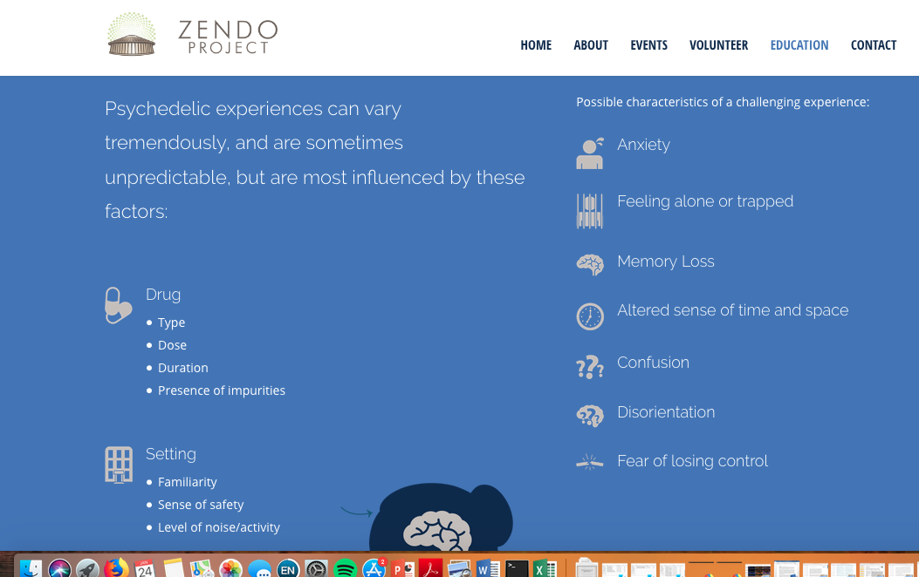
Mindset
Intention / expectation
Emontional state
Psychological well-being
Previous bad experience w/ substance
https://www.zendoproject.org/education/

Slide 27
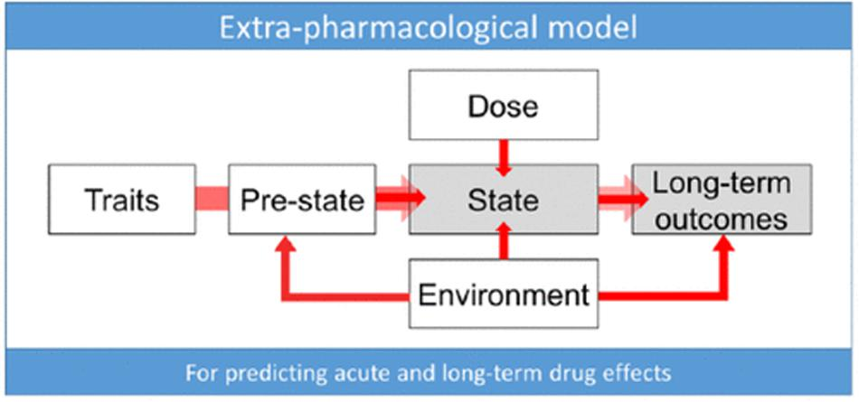
Swanson, L.R. 2018

Slide 28
Brief History on Psychedelic Research

Slide 29
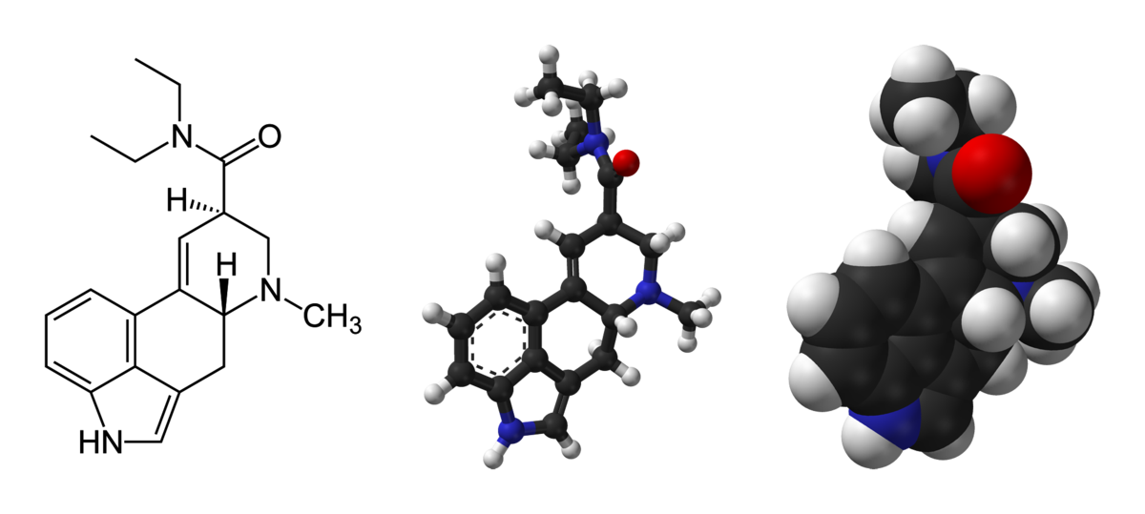
“A portion of the self overflows into the outer world, into objects, which begin to live, to have another, a deeper meaning,"
Albert Hoffman (1943)
Discovered LSD accidently
Bicycle Day
Found Psilocybin was psychoactive compound
Onset duration
5-HT found in brain in 1953
Structural similarities lead to hypothesis that LSD may be interfering with 5-HT
Brain chemistry effects behavior
Initially model for mental illness

Slide 30
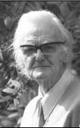
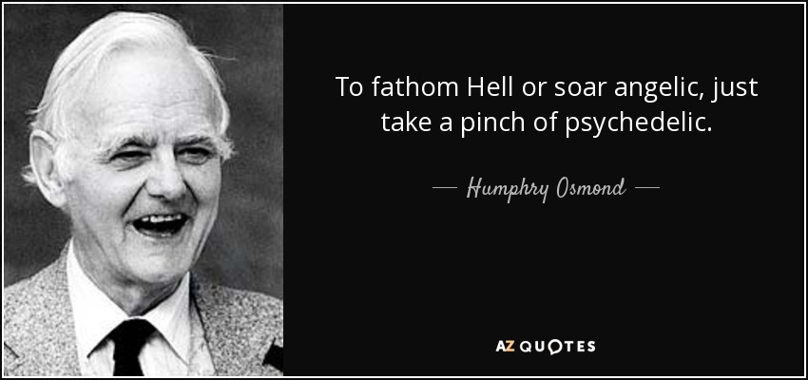
Humphry Osmond – British psychiatrist in 1950’s
Coined term “psychedelics”
”Mind Manifesting”
Psyche – ”mind”
Delos – “manifest”
Early work focused on treating alcoholism using LSD
Delirium tremens
50% success
Bill Wilson one of his patients
Founder of Alcoholics Anonymous

Slide 31
50’s & 60’s
Thousands of studies examining the therapeutic potential of LSD
Most inconclusive, serve mostly as pilot data
However, some studies showed promising and reliable results for using LSD to treat alcoholism + end of life distress

Slide 32
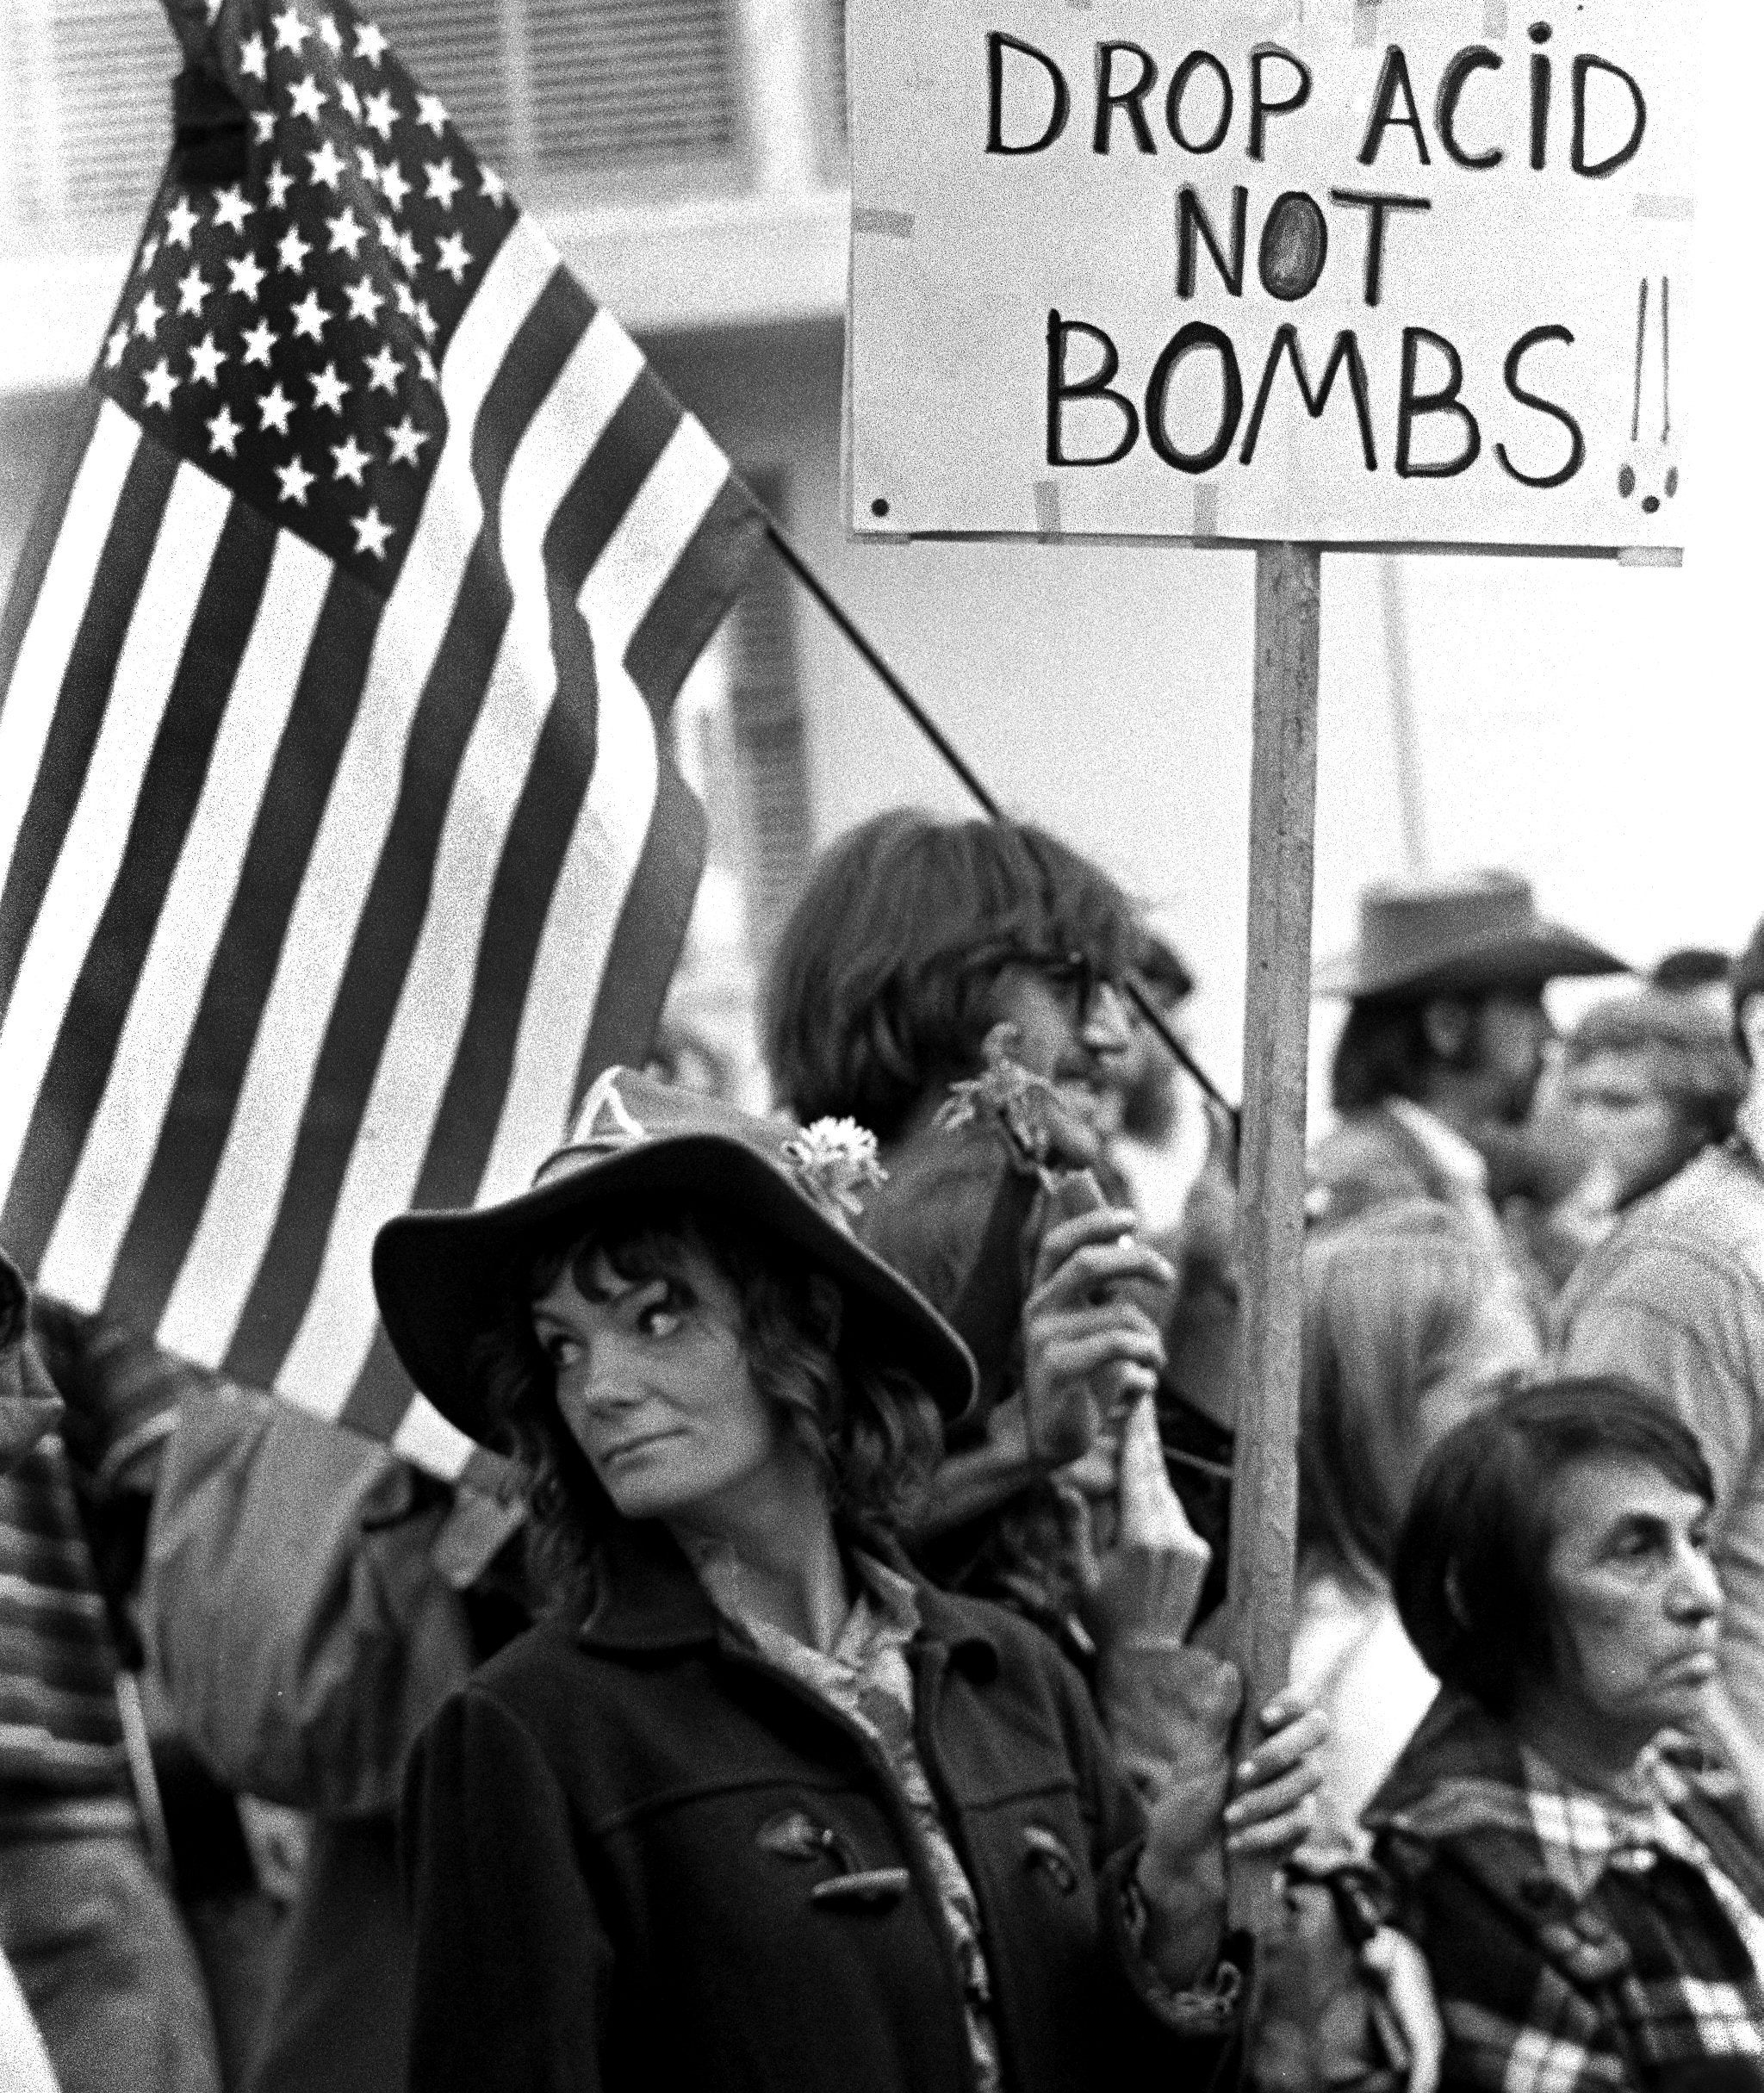
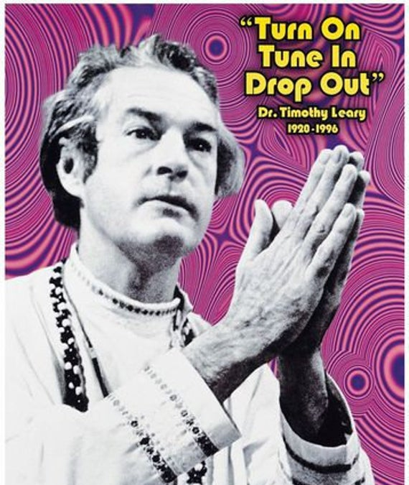
60’s & 70’s
Counter-Culture associated with use of drugs like cannabis and psychedelics
Harvard psychologist Timothy Leary became poster-child for the counter-cultural psychedelic movement
“Most dangerous man in America“
- Richard Nixon

Slide 33
1970 Controlled Substances Act
Nixon passes the Controlled Substance Act
All psychedelics are classified as Schedule I substances in the U.S.
High potential for abuse
No medicinal value
Lack of safety under medical supervision
All research is brought to an abrupt halt for decades

Slide 34
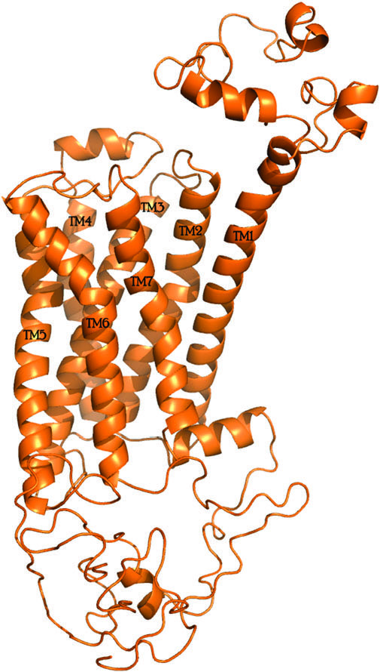
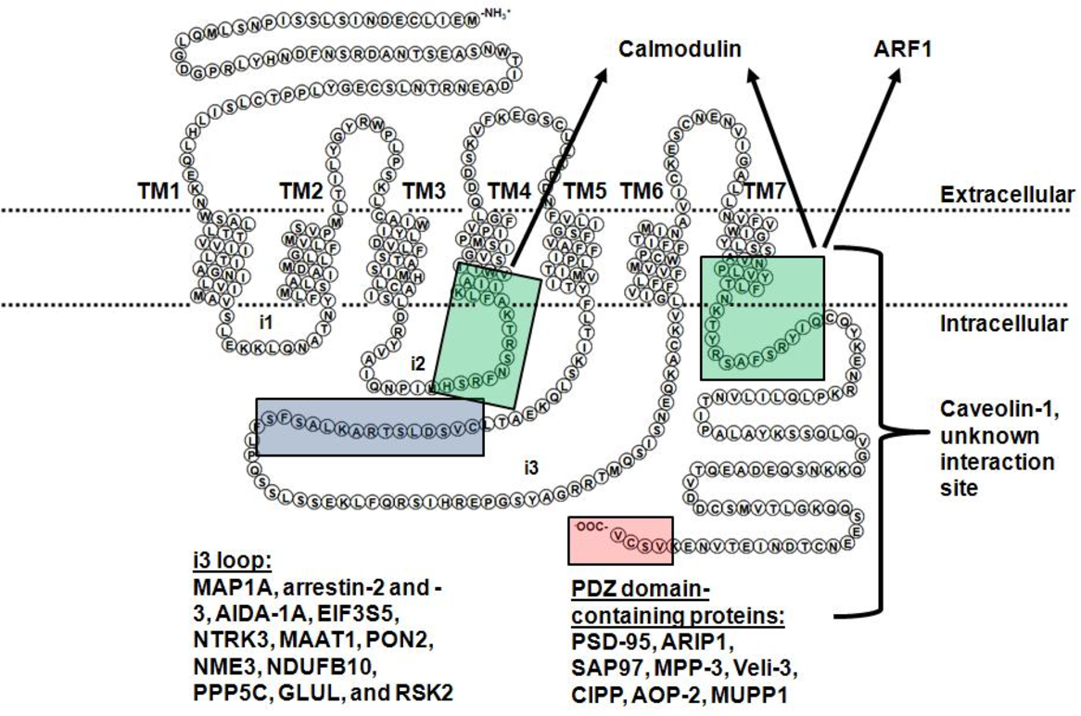
Serotonin-2A Receptor (5-HT_{2A})
Kanagarajadurai et al. 2009
- Most widely expressed 5-HT receptor in mammals
- Found in every tissue type examined

Slide 35
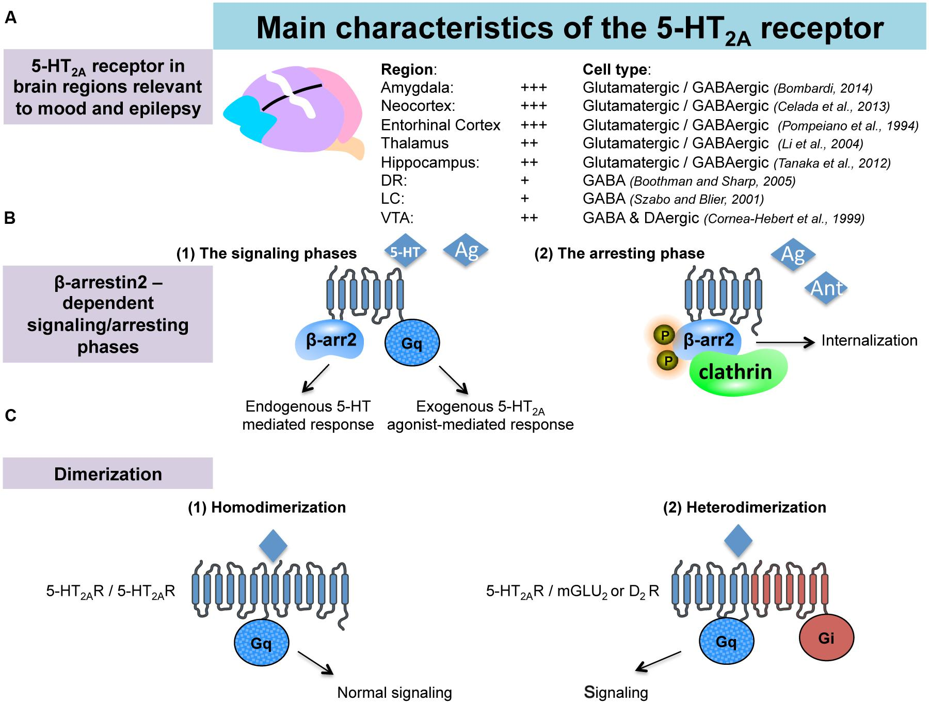
Serotonin-2A Receptor (5-HT_{2A})
Guiard & Giovanni 2015

Slide 36
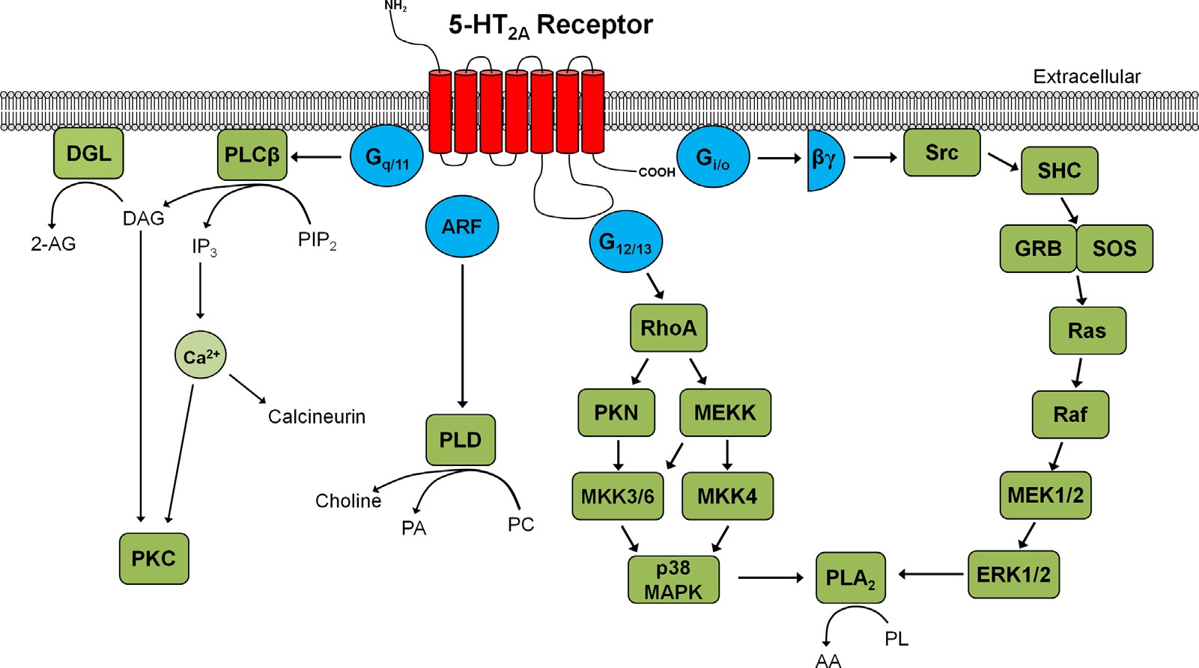
Serotonin-2A Receptor (5-HT_{2A})
(Halberstadt 2014)

Slide 37
(Antagonists)

Slide 39
Serotonin-2A Receptor (5-HT_{2A})
Guiard & Giovanni 2015

Slide 40
Guiard & Giovanni 2015

Slide 41
5-HT_{2A} Receptor Functional selectivity
IP₃ and Phospholipase C pathways
↑ [Ca⁺⁺]
↑ Arachidonic Acid (AA)
Extracellular signal-related Kinase signaling
β-arrestin transduction
Hallucinogenic agonists (LSD + DOI)
**Ser²⁸⁰ phosphorylation on i3 loop**
Critical for psychedelic induced desensitization (tolerance)
Karaki S., et al. 2009

Slide 42
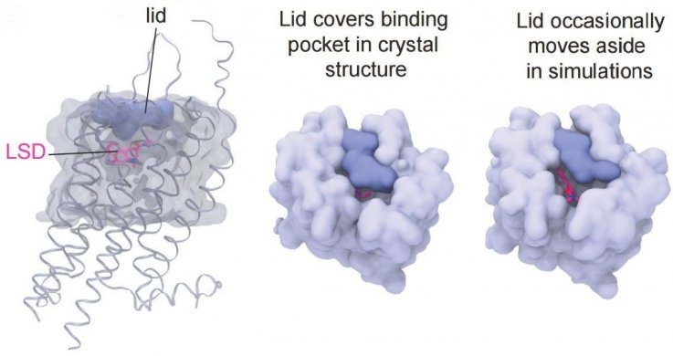
LSD
G_{q} Ca⁺⁺ influx occurs within seconds/minutes after receptor binding to 5-HT_{2A}
β-arrestin recruitment after LSD treatment increases over time
Max after 5 hours
Eth-LSD more potent at β-arrestin recruitment
Beyond 5-HT max
“superagonist”
McCorvy JD, et al. 2019

Slide 43
5-HT2A Receptor - Localization
Adult macaque monkey (Area 46- Prefrontal Cortex)
5-HT2A in almost all, if not all pyramidal neurons
layers II, III, V (primary output), VI
Includes dendrite branches in layer I
5-HT2A not in Layer IV (thalamus input)
Found pre and post synaptically

Slide 44
5-HT2A density highest on Apical Dendrites
--> less on the cell bodies
P = Pyramidal cells
NP = Non-pyramidal
* = unlabeled pyramidal cells

Slide 45
Medium (open arrow head) and large (*) inhibitory interneurons
some Calbindin⁺

Slide 46
Autoradiography in rats - expression of 5-HT_{2A}
¹²⁵I-DOI. 0.5 nM
mPFC + frontoparietal cortex
(Marek et al. 1999)

Slide 47
Mouse mPFC
ACC
PrL
IL
Price et al. 2019

Slide 48
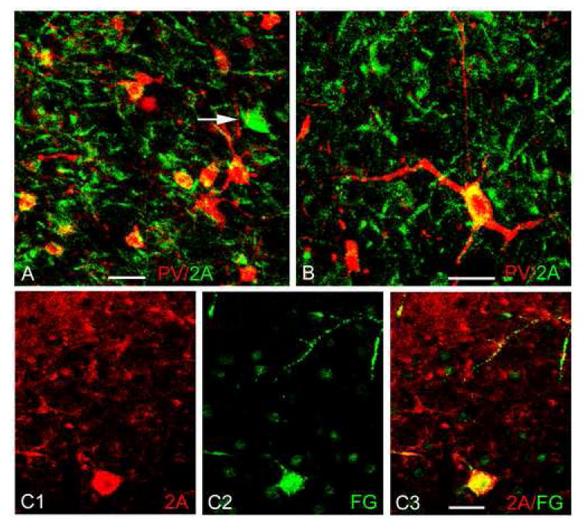
In the Basolateral Amygdala (rat)
5-HT_{2A} localized on excitatory pyramidal neurons in the anterior and posterior BLA
Also on inhibitory interneurons
Mostly Parvalbumin (A & B)
Also some Somatostatin
Not Cholecystokinin
C1-3)
5-HT_{2A} expressing non-excitatory neurons co-labeled with a retrograde green fluorogold injection into the Mediodorsal Thalamus
Anterior + posterior BLA
Not PV, CCK, or SOM
NPY??
McDonald* and Mascagni 2007

Slide 49
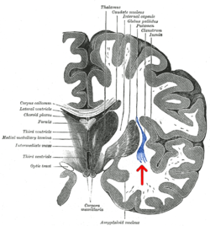
Claustrum
Bilateral grey matter structure
Consciousness / attention
Integration of sensory modalities?
High expression of
5-HT_{2A} + 𝜅-opioid receptors

Slide 50
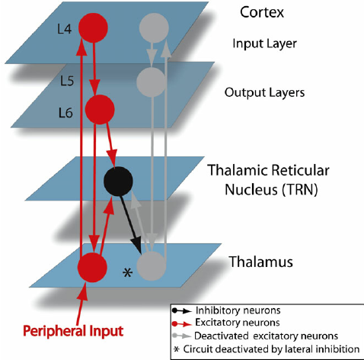
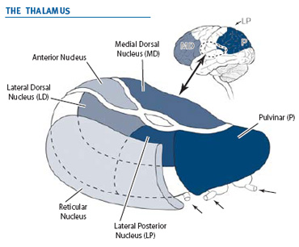
Thalamic Reticular Nucleus
Sheath of GABAergic interneurons that surrounds the thalamus laterally
Aizenberg et al., 2019
Ferrarelli & Tononi 2010

Slide 51
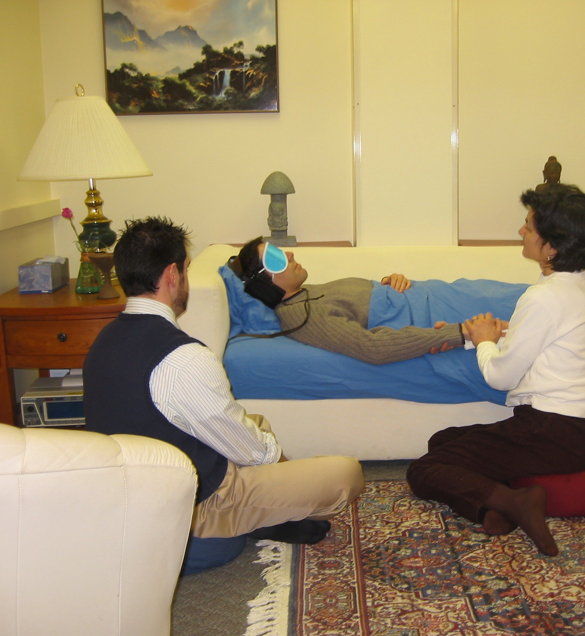
Clinical Trials w/ Psychedelics
Prescreen patients
Prepare patients for what to expect
Administer drugs in safe & controlled environment
Therapists present
Hands-off approach
(unless assistance is required)
Encourage patients to explore inner journey – go where it takes you
Blind fold + music in headphones
Provide integration sessions post drug administration & assess patients
For addiction trials:
Patients prepare by focusing on reasons for quitting ahead of time
Goal-orientated
Encouraged to focus on thinking about reasons for quitting after drug administration
Interestingly “Bad Trips” seem to have value here (60 Minutes)
Follow up integration sessions

Slide 52
Current Therapeutic Applications
Anxiety/Depression
Nicotine/Alcohol Addiction
Alzheimer’s
Obsessive Compulsive Disorder
Eating Disorders
Cluster headaches
Lyme's disease
Sleep Disorders

Slide 53
Potential long-term effects of psychedelics on cognition
Certain cognitive traits associated with creativity can increase under psychedelics (Sessa, 2008; Baggott, 2015)
Cognitive flexibility and optimism can remain for up to 2 weeks after the main acute drug effects have dissipated (Carhart-Harris et al., 2016b).
Furthermore, long-term increases in creative problem-solving ability (Sweat et al., 2016)
Increased trait openness after one psychedelic experience MacLean et al., 2011; Lebedev et al., 2016)
In supportive environments, classic psychedelic drugs can promote:
Feelings of trust, empathy, bonding, closeness, tenderness, forgiveness, acceptance, and connectedness (Dolder et al., 2016; Belser et al., 2017; Carhart-Harris et al., 2017b; Pokorny et al., 2017; Watts et al., 2017).
Swanson, L.R. 2018

Slide 54
(Schmidt et al. 2015)
LSD induced profound altered state of consciousness that lasted for 12 hours
Visual hallucinations
Visual-auditory synesthesia
Positively experienced derealization and depersonalization
Increased subjective well-being, happiness, closeness to others, openness, and trust compared to controls
Increases in:
blood pressure, heart rate, body temperature, pupil size
plasma cortisol, prolactin, oxytocin, and epinephrine
200 µL of Lysergic Acid Diethylamide (LSD) in healthy volunteers
Double-blind, randomized, placebo-controlled crossover study

Slide 55
Anxiety & Depression
Terminally ill cancer patients with anxiety
LSD + Psilocybin reduced anxiety associated with terminal cancer diagnoses & fears surrounding death
Treatment-resistant depression
2 doses of psilocybin reduced depression (12 individuals)
Therapeutic relief can last up to 6 months with one administration

Slide 56
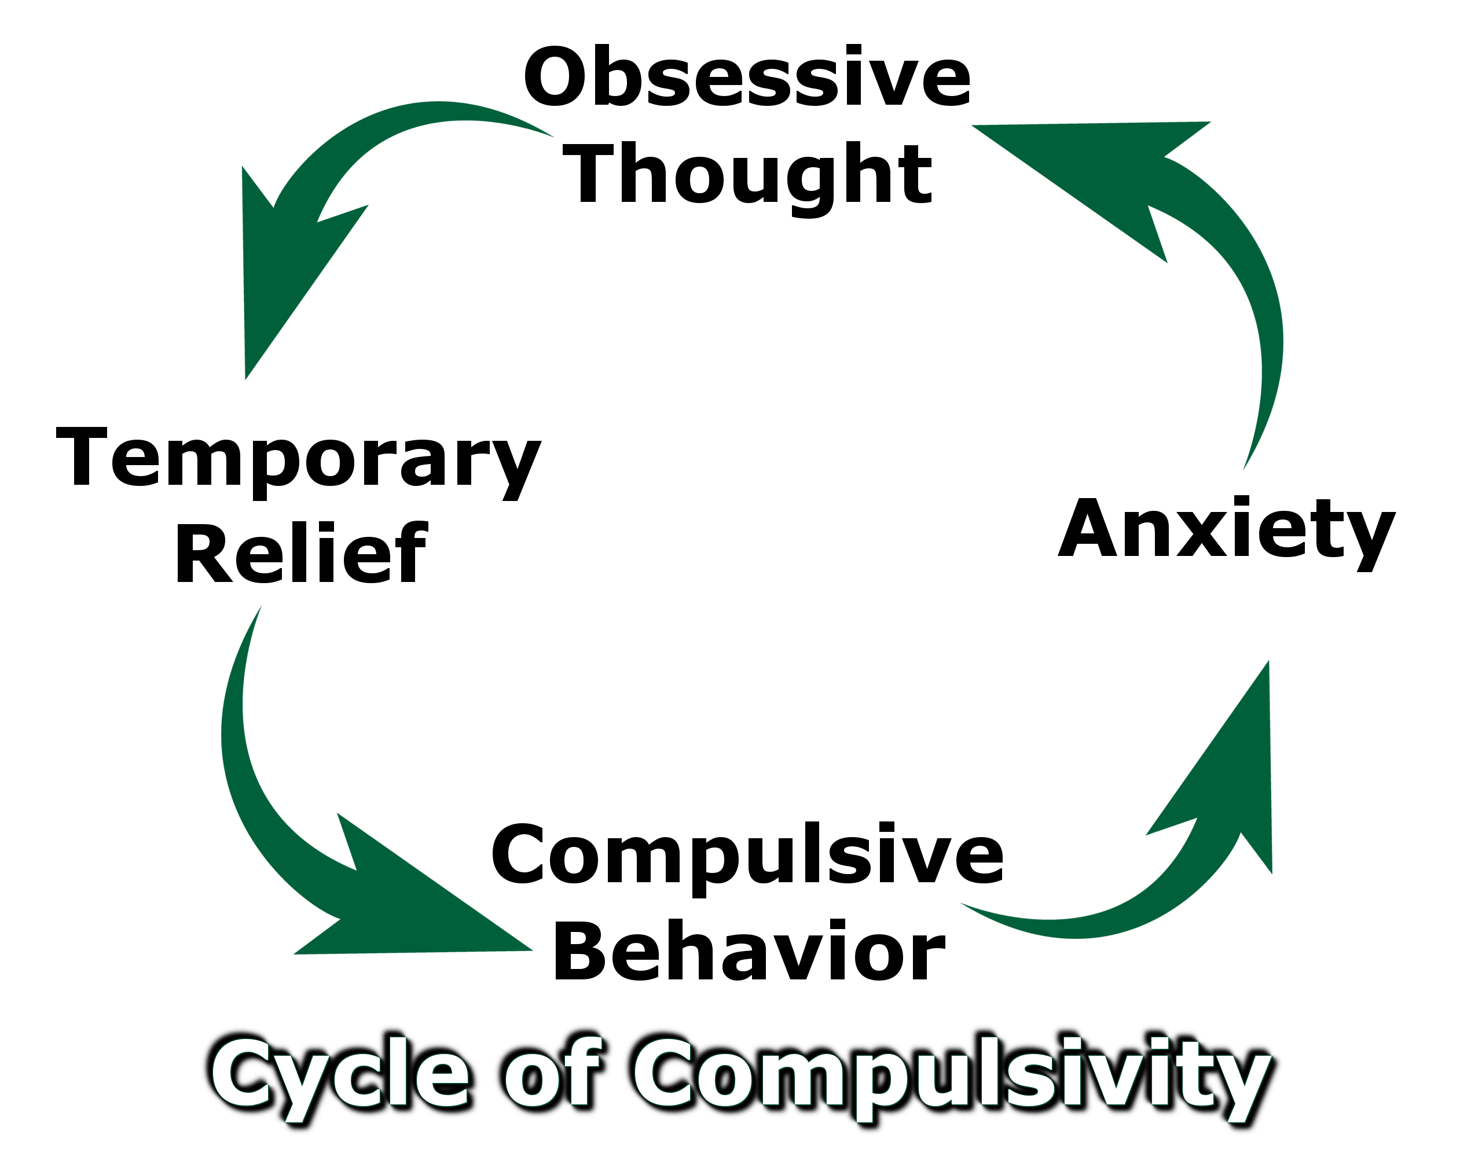
Obsessive Compulsive Disorder (OCD)
Decreased OCD symptoms (by 23–100%) on the Yale–brown obsessive-compulsive scale
patients previously treatment resistant

Slide 57
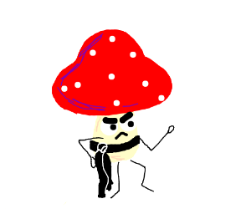
Addiction
Treatment for nicotine addiction and alcoholism
People report increased executive control of their behavior
Recognize when cravings occur
15 treatment resistant smokers – psilocybin vs nicotine patch (Johnson, MW et al. 2019)
1-year post treatment
56% psilocybin treated still abstinent
17% nicotine patch still abstinent
(Nichols 2016) “After this “sense of self,” reassembles at the end of the psilocybin experience, there appears to be a chance of abandoning habits and repetitive thoughts that no longer serve a useful purpose for the person”

Slide 58
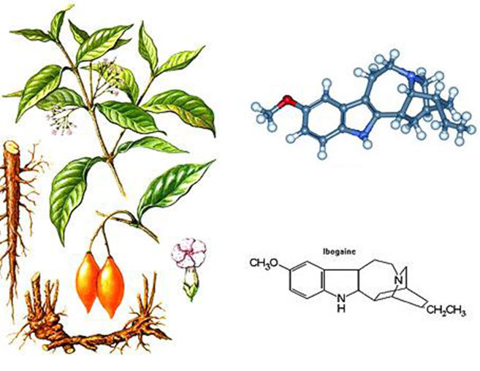
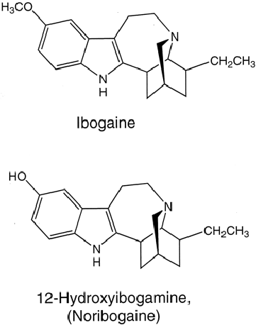
Ibogaine + opioid addiction
Brown & Alter 2017
Noller, Frampton & Yazar-Klosinski, 2017
Ibogaine → Noribogaine

Slide 59
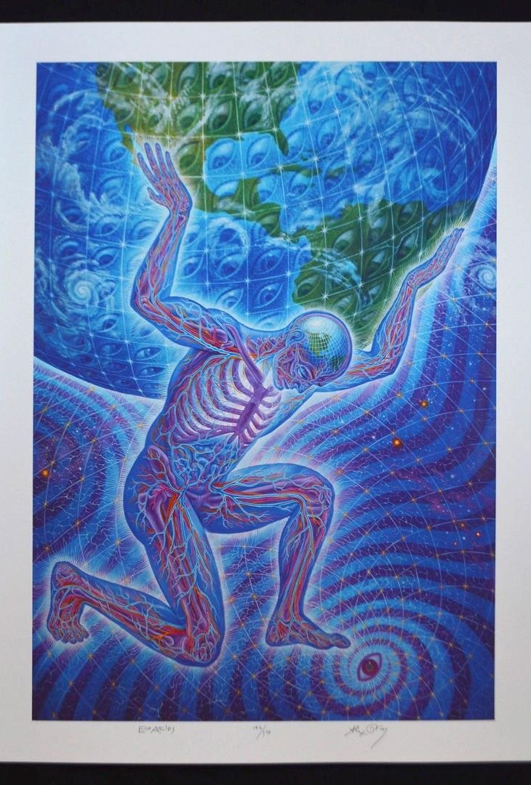
“Lifetime experience with (classic) psychedelics predicts pro-environmental behavior through an increase in nature relatedness” (Forstmann & Sagioglou 2017)
general population online survey
More likely to be concerned about environmental issues through nature relatedness and ecological behaviors like recycling, saving water
“Using structural equation modeling, found that experience with classic psychedelics uniquely predicted self-reported engagement in pro-environmental behaviors, and that this relationship was statistically explained by people’s degree of self-identification with nature”

Slide 60
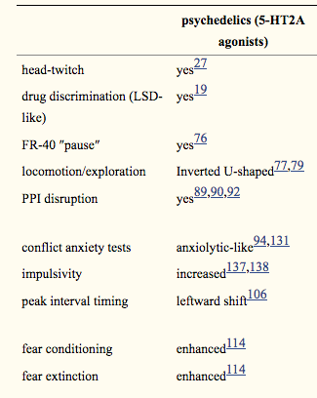
Animal Models
Hanks & Gonzalez-Maeso 2013
1. 5-HT2A agonists (DOI) anxiolytic in the EPM
0.5, 1, 2 mg/kg
2. Facilitate fear conditioning and extinction depending on time of administration
3. Increase impulsivity in a D₂ dependent manner
Chronic LSD treatment → persistent behavioral abnormalities lasting long after drug administration ends
DOI attenuates ethanol consumption
PMID: 31309240

Slide 61
Induced by serotonergic psychedelics
Not non-psychedelic 5-HT_{2A} agonists (Lisuride)
Absent in 5-HT_{2A}^{-/-} KO mice
Restored by selective restoration in cortical pyramidal cells
Infusion of DOI into the prelimbic cortex sufficient (Willins & Meltzer 1997)
But… HTR also reported to be induced by
5HTP
SR141716A (CB₁ antagonist)
Yohimbine (alpha-2 antagonist) (reported to cause hallucinations)
Atropine (muscarinic antagonist)
mGlu2/3 agonist LY354740 blocks HTR
mGlu2 KO block HTR but not mGlu3 KO
Restoring mGlu2 expression in frontal cortex neurons restores HTR
mGlu2 KO mice do not show HTR (LSD or DOI)
(Halberstadt & Meyer 2013)
Head Twitch Response (HTR)

Slide 62
HTR Potency(rodent) & Hallucinogenic Potency (human)

Slide 63
Proposed mechanism

Slide 64
Theories Regarding Mechanisms of Action

Slide 65
Psychedelics promote dendritic spine growth
Layer V cortical neurons
Dependent on:
5-HT_{2A} activation
BDNF activity
mTOR activity
D. Olson 2018

Slide 66
(weight and the size of the nodes is proportional to their strength)

Slide 67
Psilocybin ↑ Global Brain Connectivity (GBC) across sensory areas
Psilocybin ↓ GBC in associative regions
Griffiths et al. 2020

Slide 68
iii) Psi-induced changes in GBC emerge over time from administration to peak-effects
Griffiths et al. 2020

Slide 69
T1 = 20 min post admin.
T2 = 40 min post admin.
T3 = 70 min post admin.
Griffiths et al. 2020

Slide 70
Griffiths et al. 2020

Slide 72
Decreased activity in the ACC/medial prefrontal cortex (mPFC) was a consistent finding
Magnitude of this decrease predicted the intensity of the subjective effects
Regions consistently deactivated w/ Psilocybin have unusually high metabolic activity under “normal conditions”
PCC 20% higher metabolism than other brain regions

Slide 73
Aldous Huxley’s “cerebral reducing valve.”
On the ‘inlet’ (right) side of the cerebral reducing valve is a vast ocean of all possible perceptual, emotional, and cognitive experiences.
On the ‘outlet’ (left) side is our moment-to-moment stream of experience in normal waking life.
Mechanisms inside the valve ‘reduce’ the character and contents of experience, ‘canalizing’ the ocean of possible experience into a more limited stream of waking consciousness aimed at maximum biological utility.
Aldous Huxley’s “cerebral reducing valve.”
“What I have called the cerebral reducing valve [is a] normal brain function that limits our mental processes to an awareness, most of the time, of what is biologically useful” (Huxley, 1999, p. 121).
Emerges developmentally during the course of psychological maturity
For a period during childhood, before the cerebral reducing valve has fully developed, there is this capacity to live in a kind of visionary world.
Once the valve is fully developed, normal waking life becomes restricted to a “world fabricated by our everyday, biologically useful and socially conditioned perceptions, thoughts and feelings” (Huxley, 1961a, p. 214).
Swanson, L.R. 2018

Slide 74
While evolutionarily adaptive and biologically useful, could develop pathological characteristics in two distinct ways.
1. A chronically overactive filter limits too much of the mind, causing a rigid, dull, neurotic life in which mental contents become overly restricted
2. Second, a chronically underactive or ‘leaky’ filter places too few constraints on the mind and allows too much ‘Mind at Large’ to enter conscious awareness, potentially resulting in perceptual instability, cognitive confusion, or hallucination.
How can model of psychosis aid in psychotherapy?
Psychedelic drugs may temporarily ‘disable’ brain filtration mechanisms
Could allow patients and therapists to work outside of the patient’s everyday (pathological) inhibitory mechanisms
Huxley seems to favor the position that psychedelic experience reveals a wider ontological reality and grants epistemic access to greater truth.
Osmond’s view, on which these drugs reveal normally hidden aspects of mind (unconscious mind)
Unclear exactly what it is that the brain is filtering and consequently what it is that emerges when the filter is pharmacologically perturbed by a psychedelic drug.
Swanson, L.R. 2018

Slide 75
Pathological State of Immune System
Uncontrollable activation, inducing tissue destruction rather than healing.
Asthma. Allergic rhinitis, Autoimmune diseases, Type 1 diabetes, rheumatoid arthritis (RA), and lupus
Traditional treatments attempt to
Prevent or decrease inflammation response, but suppress immune system
Key role in depression / addiction
Injections of proinflammatory agents TNF-α and IL-1β in healthy animals
- Behavior similar to social withdrawal

Slide 76
5-HT & Inflammation
Generally thought of as pro-inflammatory
5-HT depletion → ↓ inflammation
↑ 5-HT in blood associated with ↑ cytokines (IL-6 & TNF-α) & vice versa
5-HT_{2A} in
vascular smooth muscle
Activation = ↑ inflammatory cytokine IL-6
Inhibition = ↓IL-6

Slide 77
Psychedelics & Inflammation
DOI (and LSD) potently reduces TNF-α (rat smooth muscle cells)
- IC₅₀ concentrations 10–20 pM
Inhibited the TNF-a induced expression of genes encoding
Intracellular adhesion molecule-1 (ICAM-1),
Vascular cell adhesion molecule-1 (VCAM-1),
Blocked activation and nuclear translocation of NF-𝜅B
Blocked activation nitric oxide synthase activity
2,5-Dimethoy-4-iodoamphetamine
(DOI)

Slide 78
(R)-DOI & inflammation in vivo
Systemic (R)-DOI has therapeutic effects at extremely low doses in treating multiple peripheral inflammatory disorders
Continuous delivery of (R)-DOI at extremely low concentrations
Steady plasma concentration of 0.5 ng/mL (1.5 μg/hr)
Extraordinary therapeutic efficacy in preventing high fat diet induced pro-inflammatory gene expression of several markers in peripheral tissues.
Systemic (R)-DOI
↓ circulating TNF-α and IL-6 (as low as 0.01 mg/kg)
Nebulized (R)-DOI reduced airway inflammation in rodent model of asthma
Other psychedelics like LSD & psilocybin also anti-inflammatory but not as potent as (R)-DOI
*Dependent on 5-HT_{2A} not _{2B/2C}*
Flanagan, TW & Nichols, CD 2018
Flanagan, TW et al. 2019

Slide 79
Terrace Mckenna – Stoned Ape Hypothesis

Slide 80
“It does not seem to be an exaggeration to say that psychedelics, used responsibly and with proper caution, would be for psychiatry what the microscope is for biology and medicine or the telescope is for astronomy. These tools make it possible to study important processes that under normal circumstances are not available for direct observation”
(Stanislov Grof, 1980).

Slide 81
Limitations
Takes up a lot of time for therapists (expensive)
Problem with placebo
Animal Models
Rodents don’t self-admin. psychedelics
Conflict w/ human behaviors
Unknown how expectations effect acute/long term outcomes
Unknown how therapists/researcher’s expectations towards treatment influences patient outcomes (reverse placebo)
Understanding of mechanisms of action of acute / long term effects
Hallucinogenic Persisting Perceptual Disorder (HPPD)
Most studies to have low sample sizes and are open-label/feasibility studies
Should therapists in psychedelic clinical trials have experienced the effects of psychedelics themselves?

Slide 82
Non-Serotonergic Psychedelics

Slide 83
Dissociative
Ketamine [NMDA-R Antagonist]
Phencyclidine (PCP) [NMDA-R Antagonist]
Salvinorin A (𝜅-opioid agonist)
Muscimol (GABA_{A} agonist)
Ketamine
Salvinorin A
PCP
Deliriant
Muscimol

Slide 84
Entactogens / Empathogens
“The main characteristic that distinguishes MDMA from LSD-type experiences is the consistency of the effects of emotional communion, relatedness, emotional openness—in short, empathy and sympathy”
(Nichols, D. 1993)
MDMA
2C-B

Slide 85
Other altered states of consciousness
Meditation
Prayer
Sensory deprivation
Breathing technique
Yoga, hypnotism
Chanting
Rituals

Slide 86
Helpful Resources:

Slide 87
Ayahuasca
DOI
K_{i} 5-HT_{2A} (nM) = 0.7
LSD
K_{i} 5-HT_{2A} (nM) = 2.4
DMT
K_{i} 5-HT_{2A} (nM) = 237
Psilocin
K_{i} 5-HT_{2A} (nM) = 15- 25
Mescaline
K_{i} 5-HT_{2A} (nM) = 550

